Slide 1
Smart Responsive HTML Website
Creating a responsive layout with HTML, CSS, and JavaScript
Adnan Majeed

Slide 2
Install xampp server
Open xampp server in c drive
Open htdocs folder from xampp folder
Save all of your php files in xampp htdocs folder
Open xampp control panel
Start apache and mysql services
Start your web journey
Save file.php and styles.css file in htdocs folder

Slide 3


Slide 4
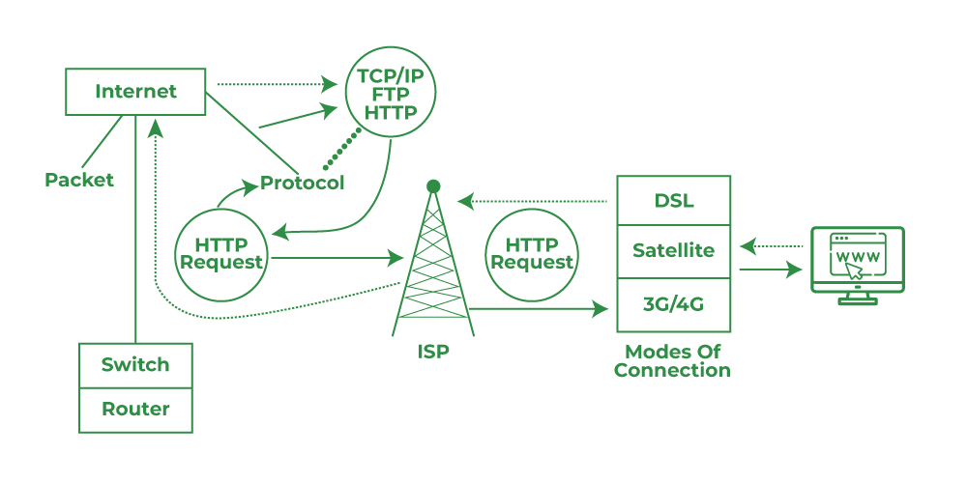
How does internet works

Slide 5
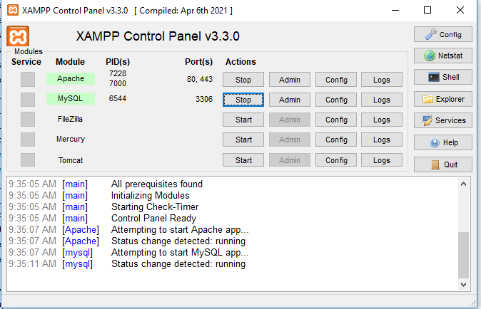
How does xampp server works

Slide 6
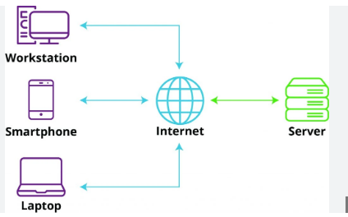
Client server architecture

Slide 7
File.php
<!DOCTYPE html>
<html lang="en">
<head>
<meta charset="UTF-8">
<meta name="viewport" content="width=device-width, initial-scale=1.0">
<title>Responsive Menu</title>
<link rel="stylesheet" href="styles.css">
</head>
<body>
<header>
<nav class="navbar">
<div class="logo">Logo</div>
<ul class="menu">
<li><a href="#home">Home</a></li>
<li><a href="#about">About</a></li>
<li><a href="#services">Services</a></li>
<li><a href="#contact">Contact</a></li>
</ul>
</nav>
</header>
<div class="content">
Responsive content goes here.
</div>
</body>
</html>

Slide 8
Styles.css
* { box-sizing: border-box; margin: 0; padding: 0; }
.navbar { display: flex; justify-content: space-between; align-items: center; padding: 10px 20px; background-color: #333; }
.logo { color: white; font-size: 24px; }
.menu { display: flex; list-style: none; }
.menu li { margin-left: 20px; }
.menu a { color: white; text-decoration: none; font-size: 18px; }
@media (max-width: 600px) {
.menu { flex-direction: column; width: 100%; }
.menu li { margin: 10px 0; text-align: center; }
}

Slide 9
Output

Slide 10
Thanks

